Slide 1

Development of machine learning models to process Electronic Health Records – Explainable Models
Week 7 Meeting, 12/11/2021

Slide 2
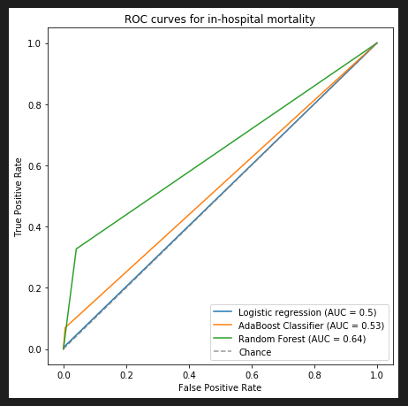
ROC curve

Slide 3
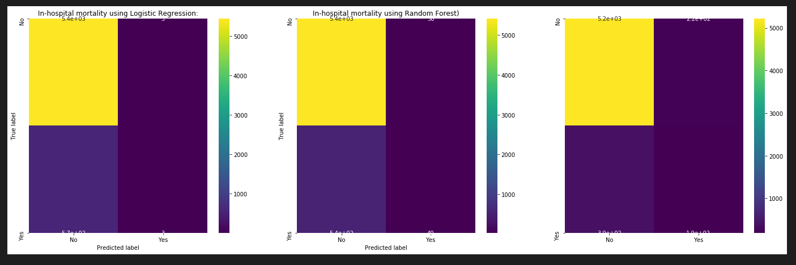
Confusion matrix

